Slide 1
KTO KARATAY UNIVERSITY
FACULTY OF ENGINEERING
DEPARTMENT OF MECHATRONICS ENGINEERING
MEM620 COMPUTER AIDED DESIGN AND PRODUCTION
ADVERTISEMENT SYSTEM LABELLING LINE
PROJECT PRESENTATION
<17.05.2024>
200313008 Mustafa polat
200313017 MUSTAFA URGAN
Asst. Prof. Hüseyin ALP and Res. Asst. Sinan İLGEN

Slide 2
TABLE OF CONTENTS
1. PURPOSE OF THE PROJECT ……………………………………………. 2
2. PROJECT CONTENTS …………………………………………………….. 3
3. MATERIALS USED IN THE PROJECT ………………………………….. 4
4. LADDER DIAGRAM OF THE PROJECT ……………………………….. 5
5. GENERAL VIEW OF THE PROJECT ……………………………………. 6
6. VIDEO OF THE PROJECT ………………………………………………… 7

Slide 3
1. PURPOSE OF THE PROJECT
This project is designed to understand and apply the basic principles of industrial automation.
It aims to optimise industrial processes by creating an automation system with the integration of components such as conveyor belts, sensors, pistons and PLCs.
The project provides a solution to automate material handling and processing processes and increase productivity.

Slide 4
2. PROJECT CONTENTS
This presentation introduces the design and operating principles of an automation system using a conveyor belt, object detection sensor, motor, valve, pneumatic piston, CPU PLC and relay.
The presentation explains in detail the object detection and operation application processes on the conveyor belt.
It also gives information about the aim of the project, the importance of industrial automation and the functions of the components used.
Finally, the results of the project and areas for future improvement are also discussed as part of the presentation.

Slide 5
3. MATERIALS USED IN THE PROJECT
Button
Fuse
Connector
Relay
Proximity (Capacitive) Sensor
Pneumatic Piston
PLC
Belt Conveyor

Slide 6
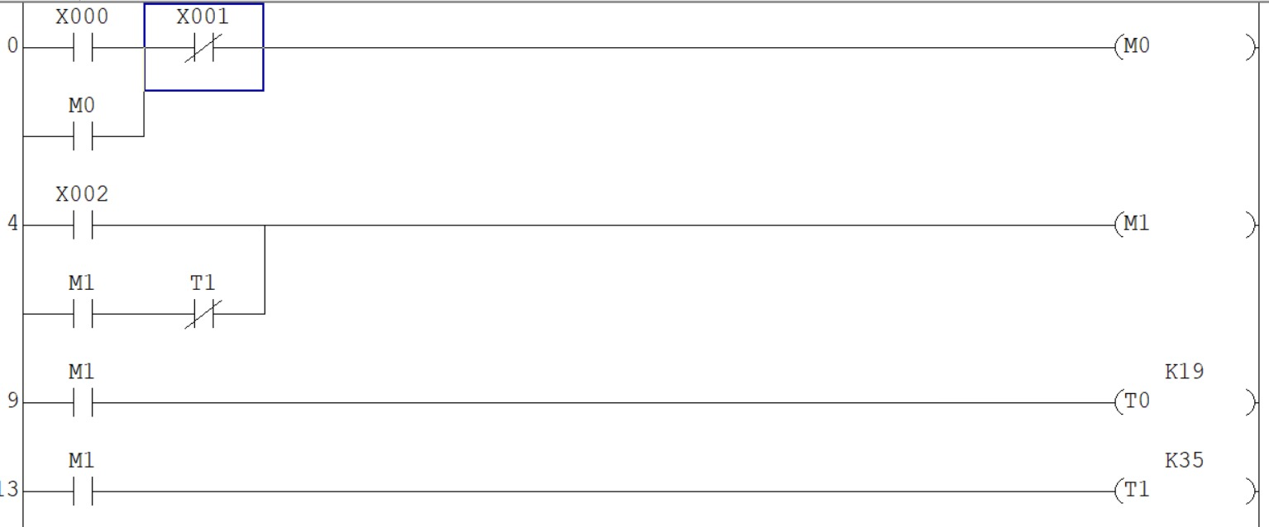
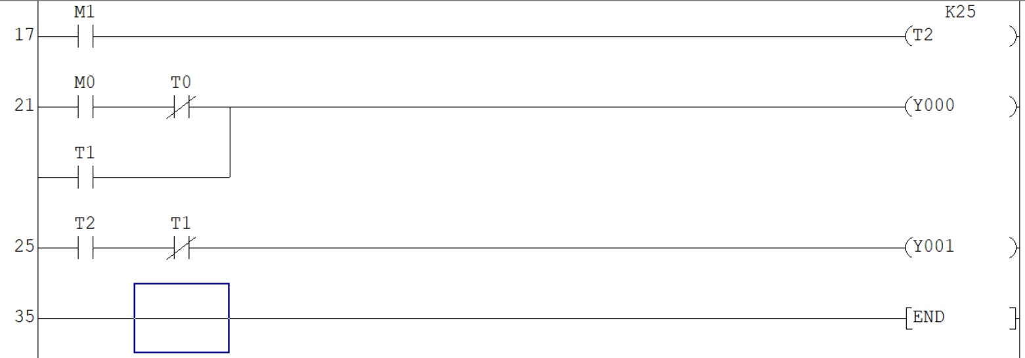
4. LADDER DIAGRAM OF THE PROJECT

Slide 7
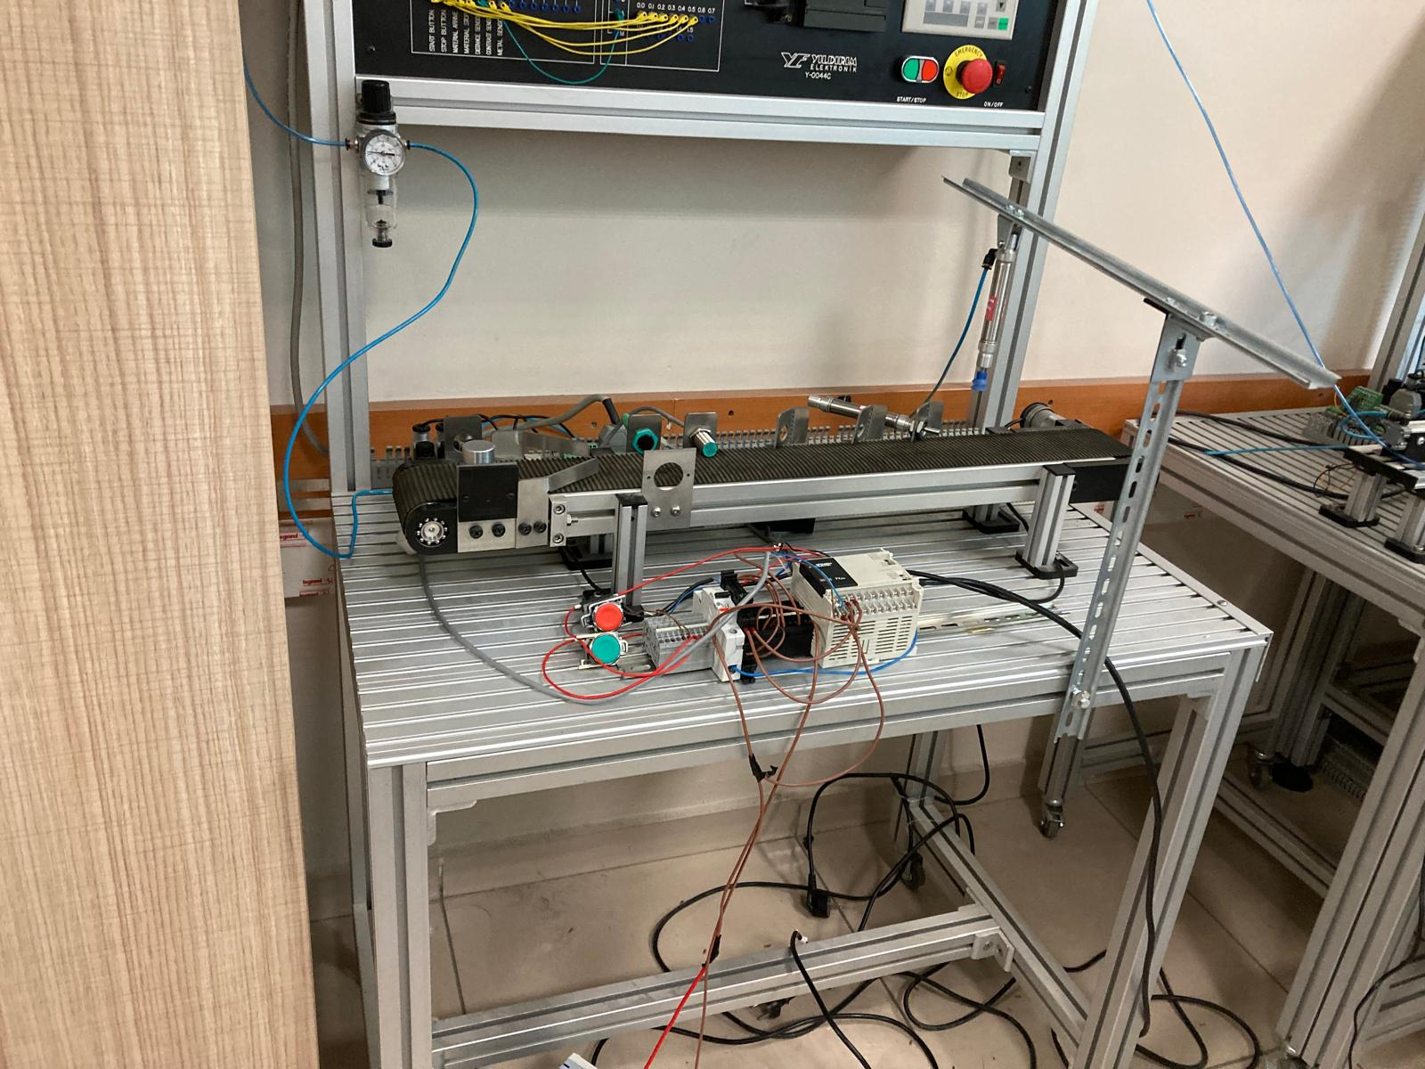
5. GENERAL VIEW OF THE PROJECT

Slide 8
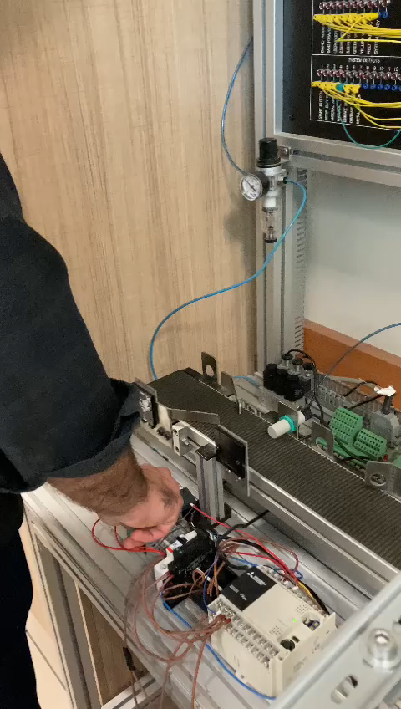
6. VIDEO OF THE PROJECT

Slide 9
THANK YOU FOR LISTENING PATIENTLY.

